Slide 1
Lecture 5
Inheritance and Polymorphism

Slide 2
Inheritance
When you just leverage the existing functionality
No problem with ambiguity
No problem with existing behavior
But what if You want to alter some functionality?
Hide the field
Hide the method
Make method virtual

Slide 3
Example with leverage
public class Human
{
int age;
string name;
public void Eat();
public void Sleep();
}
public class Student : Human
{
float GPA;
public bool Learn(String subject);
}

Slide 4
Example with method of field overload using “hide”
public class Human
{
public int age;
public string name;
public void Eat();
public void Sleep(int hours);
}
public class Student: Human
{
new public int age;
new public void Sleep(int hours);
}

Slide 5
virtual
public virtual void Eat()
{
Console.WriteLine("Human Eats");
}
public override void Eat()
{
Console.WriteLine("Student Eats");
}

Slide 6
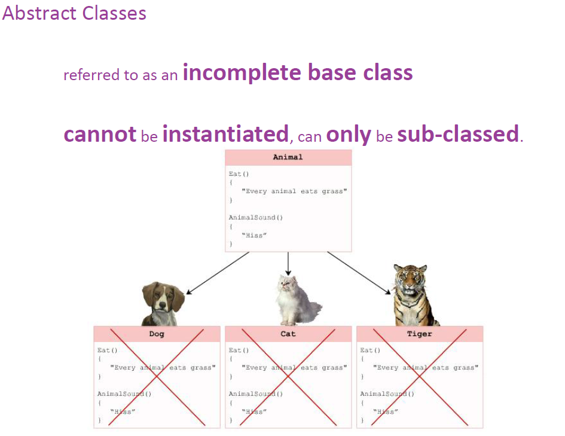

Slide 7
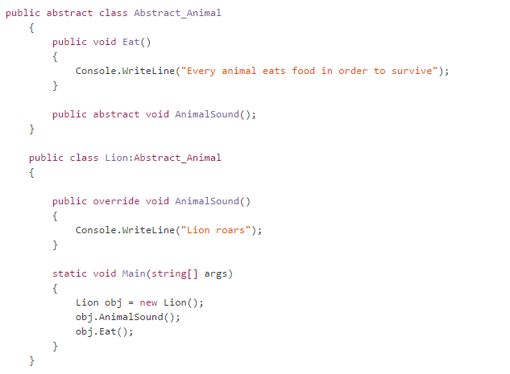
Implementation

Slide 8
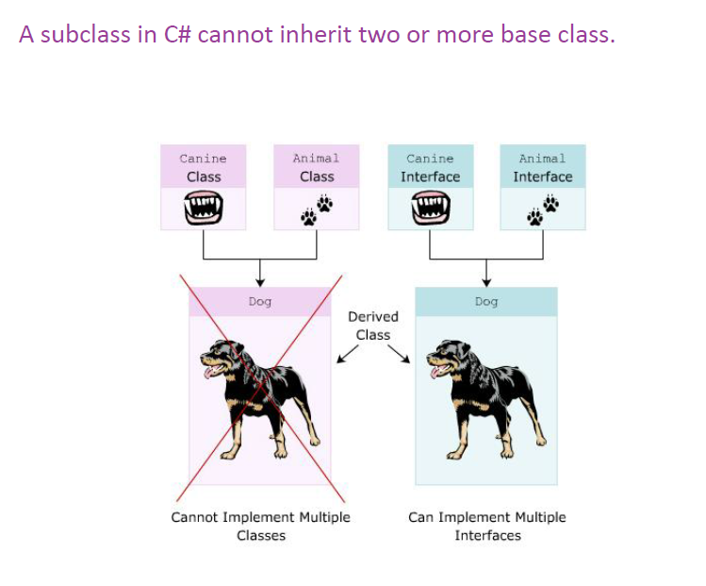
PROBLEM

Slide 9
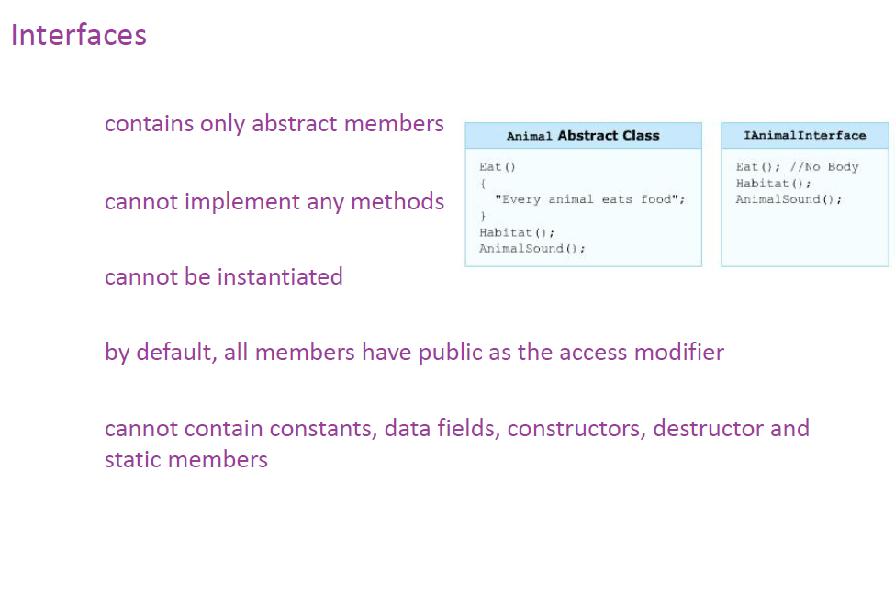

Slide 10
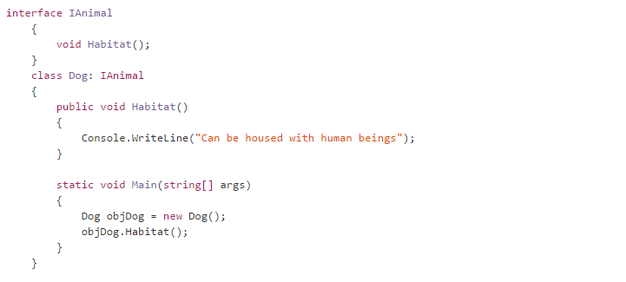
Implementation

Slide 11
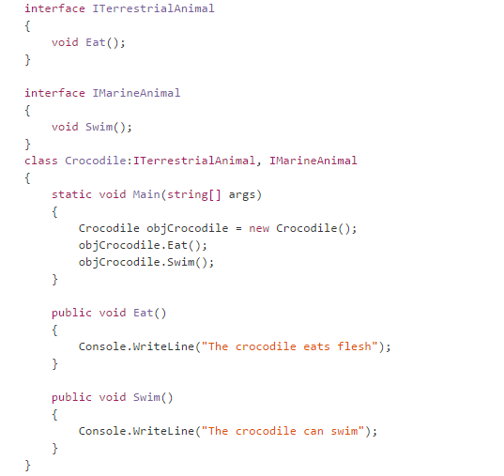

Slide 12
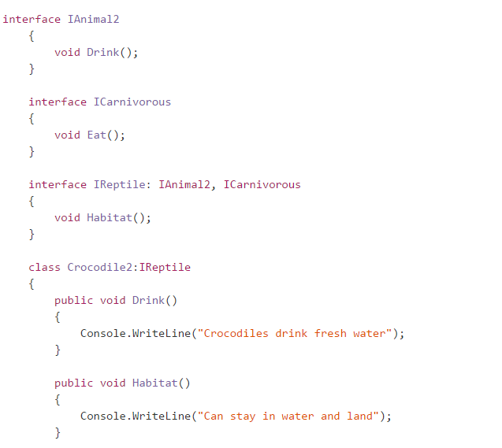

Slide 13
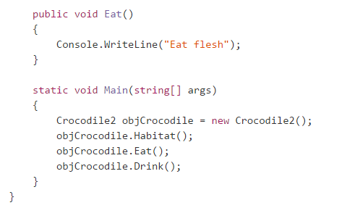

Slide 14
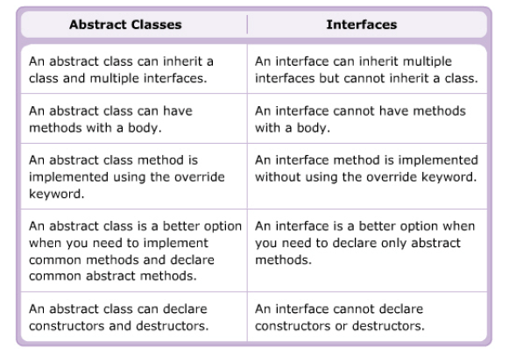
The difference between Abstract class and Interface
Interface: contract only, no implementation, no instantiation
Abstract class: contract, some implementation, no instantiation
Interface specifying what the object can do
Abstract specify what an object is

Slide 15
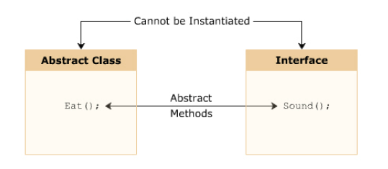
Similarities
cannot be instantiated
are implemented by the inheriting subclass
can inherit multiple interfaces

Slide 16
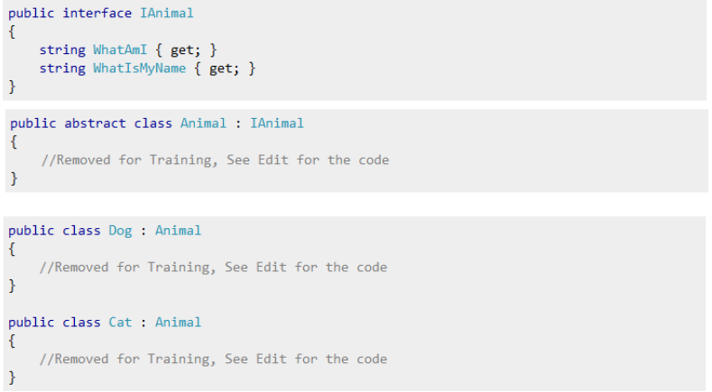
Example

Slide 17
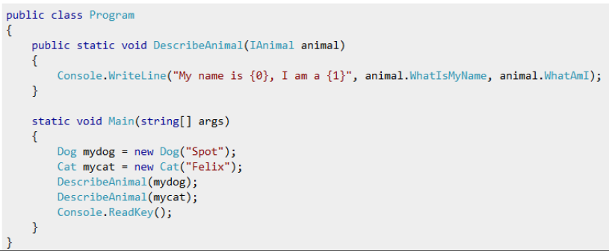

Slide 18
Recommendations
Multiple version of component
=> Abstract class
Functionality will be useful across a wide range of disparate objects
=> Interfaces
Small, concise function bits of functionality
=> Interfaces
Common, implemented functionality among all implementations of your component
=> Abstract class

Slide 19
Explicit and Implicit methods in Intefrace implementation
interface IEnglishDimensions
{
float Length();
float Width();
}
interface IMetricDimensions
{
float Length();
float Width();
}

Slide 20
class Box : IEnglishDimensions, IMetricDimensions
{
float lengthInches;
float widthInches;
public Box(float length, float width)
{
lengthInches = length;
widthInches = width;
}
float IEnglishDimensions.Length()
{
return lengthInches;
}
float IEnglishDimensions.Width()
{
return widthInches;
}

Slide 21
// Explicitly implement the members of IMetricDimensions:
float IMetricDimensions.Length()
{
return lengthInches * 2.54f;
}
float IMetricDimensions.Width()
{
return widthInches * 2.54f;
}

Slide 22
// Declare the "Box" class that implements the two interfaces:
// IEnglishDimensions and IMetricDimensions:
public static void Main()
{
// Declare a class instance "myBox":
Box myBox = new Box(30.0f, 20.0f);
// Declare an instance of the English units interface:
IEnglishDimensions eDimensions = (IEnglishDimensions) myBox;
// Declare an instance of the metric units interface:
IMetricDimensions mDimensions = (IMetricDimensions) myBox;
// Print dimensions in English units:
System.Console.WriteLine("Length(in): {0}", eDimensions.Length());
System.Console.WriteLine("Width (in): {0}", eDimensions.Width());
// Print dimensions in metric units:
System.Console.WriteLine("Length(cm): {0}", mDimensions.Length());
System.Console.WriteLine("Width (cm): {0}", mDimensions.Width());
}
}

Slide 23
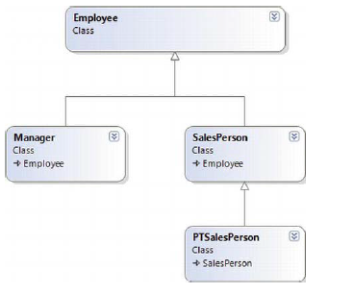
Sealed class
Situation of usefulness of sealed class
One of the examples of existing sealed
Class in Microsoft foundation class
Library is
String class

Slide 24
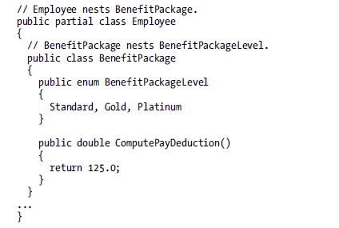
Nested class, enum, struct…
In most cases – are tightly coupled
Entities or helper classes

